Slide 1


Slide 2
Warning
It is totally normal and okay to have moments where you understand nothing in this workshop :v

Slide 3
CONTENTS
01
Getting started with ESP32
02
Getting used to ESP-IDF
03
Connecting to WiFi
04
TCP/IP sockets

Slide 4
01
Getting Started with ESP32

Slide 5
Session’s content:
Introduction to the ESP32 and its’ variants
Comparing ESP32 to Arduino UNO
Getting started with IoT Development Framework
Understand the “blink” example code

Slide 6
Introduction
ESP32 is a low-cost dual core microcontroller developed by Espressif Systems. It has both WiFi and Bluetooth integrated with various peripherals.

Slide 7
ESP32 vs Arduino UNO
Specs | ESP32 | Arduino UNO
CPU | Dual Core 160 MHz | Single Core 16MHz
Flash Memory | 4MB | 32KB
SRAM | 520KB | 2KB
GPIOs | 38 | 20
WiFi/Bluetooth | Yes | No
UART (Hardware Serial) | 3 | 1
SPI | 3 | 1
I²C | 2 | 1
Operating Voltage | 3.3V | 5V
Price | 2500DA/ 3.5$ | 2800DA/ 4$

Slide 8
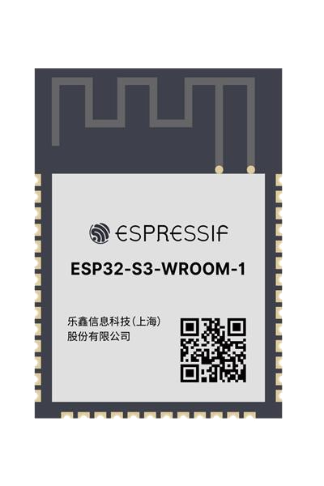
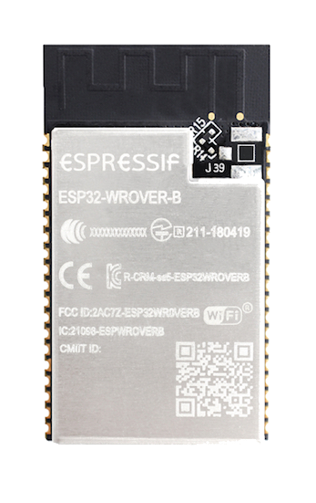
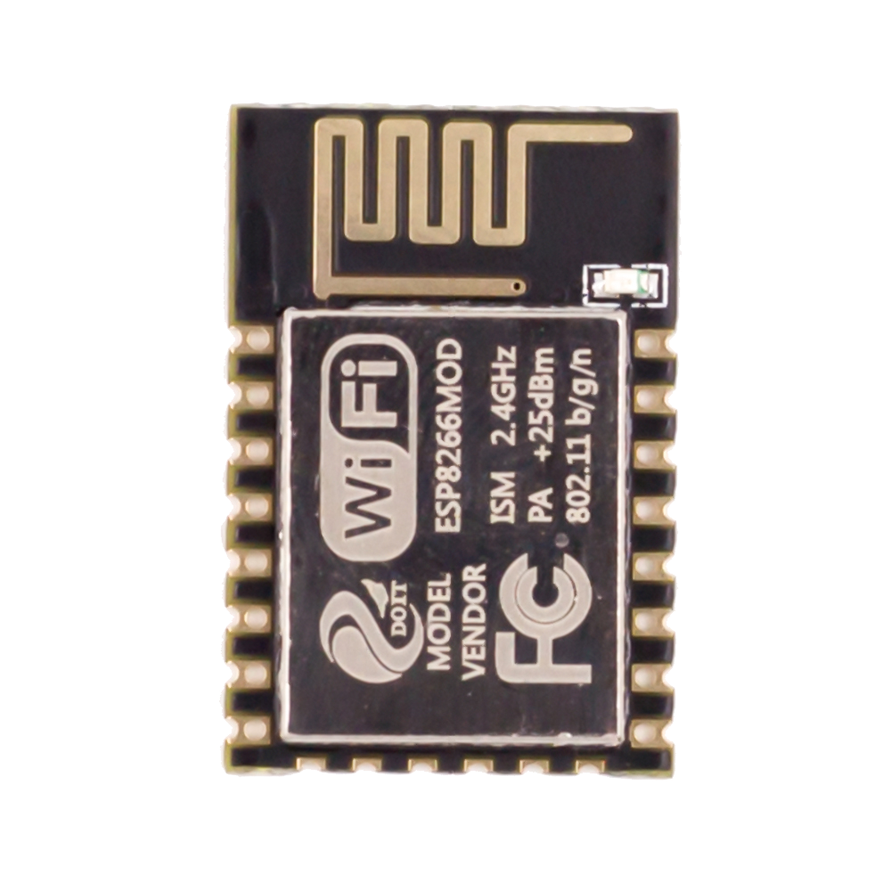
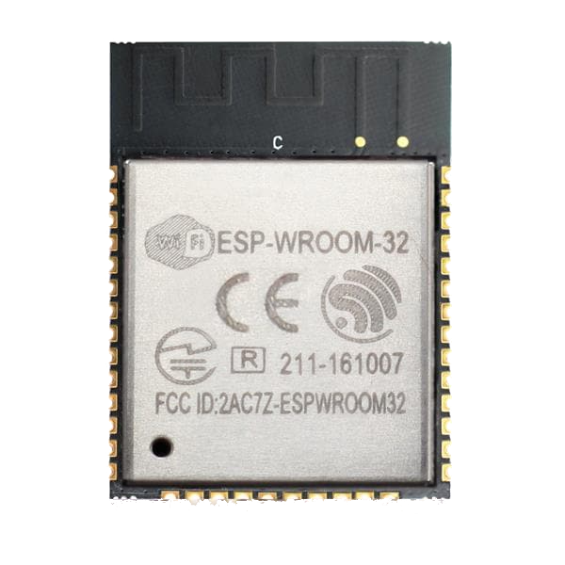
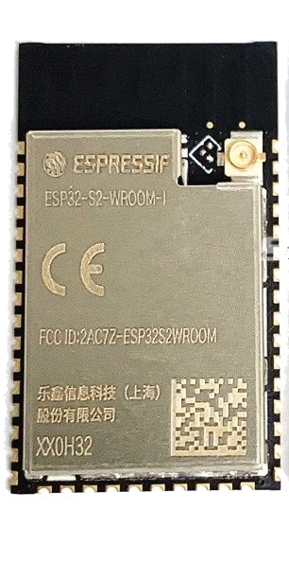
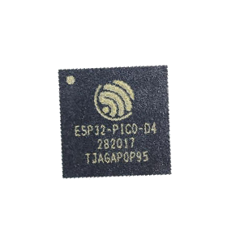
Other ESPs
ESP8266
ESP32 Wroom
ESP32 Wrover
ESP32-S2
ESP32 PICO D4
ESP32-S3

Slide 9
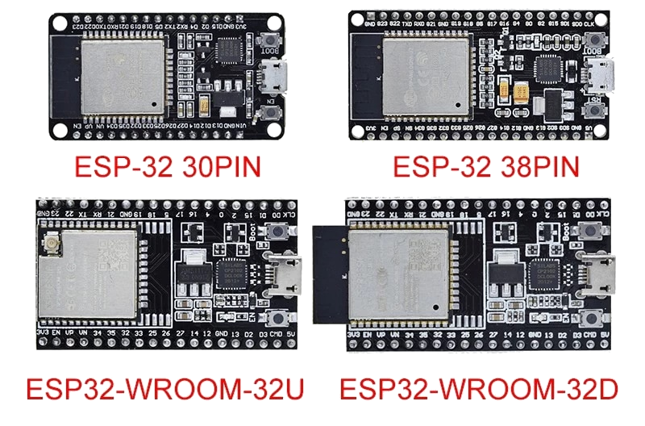
Developement boards

Slide 10
How to program the ESP32
Arduino Framework
IoT Dev Framework
micropython, lua...
Beginner friendly but thats it. Very limited, lacks many features and bad coding mindset (copy-paste)
Official framework supported by Espressif. Extremely reliable and configurable. Well documented with growing community.
Just do not use this.
You do not want a high level language when dealing with microcontrollers.
C/C++ is the way to go with embedded systems.

Slide 11
Setting up ESP-IDF
Install ESP-IDF with the esp-idf-tools-setup-offline-4.4.exe
Install VSCode
Install the Espressif IDF Extensions in VSCode
F1 or CTRL+Shift+P and search for “Configure ESP-IDF extension”
Choose “Use existing setup”

Slide 12
Your first ESP-IDF project
F1 or CTRL+Shift+P and search for “new project”
Set project name and directory then choose template
Pick the “blink” example as your project template

Slide 13
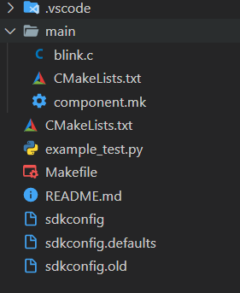
ESP-IDF Project Structure
main C file
build system related files
project configuration files

Slide 14
ESP-IDF Extension status bar
Port
Target platform
Menu Config
Build
Flash
Monitor
New IDF terminal
Project directory
Clean project
Build, Flash and Monitor

Slide 15
Arduino Framework vs ESP-IDF
Arduino | ESP-IDF
pinMode(pin, mode) | gpio_set_direction(pin, mode)
digitalWrite(pin, state) | gpio_set_level(pin, state)
Serial.printf() | printf()
delay() | vTaskDelay()
OUTPUT | GPIO_MODE_OUTPUT
INPUT | GPIO_MODE_INPUT

Slide 16
Thank you

Slide 17
02
Getting used to ESP-IDF

Slide 18
Session’s content:
Understand the “Hello World” code example
C Review of basic topics
Learn how to use the ESP-IDF documentation
Use “ESP_LOGx” instead of printf to make log statements

